Slide 1
A Final Project Report Presentation on Construction Warehouse Inventory Management System
Presented By:
Kripesh Khadka (6-2-920-10-2020)
Siddhartha Paudel (6-2-920-28-2020)
Supervised By:
Bijay Mishra

Slide 2
Presentation Outline
Introduction
Problem Statement
Objectives
Development Methodology
Requirement Analysis
Data Modeling
Process Modeling
Implementation Tool
Conclusion

Slide 3
Introduction
This project focuses on the design and implementation of an Inventory Management System (IMS).
An Inventory Management System (IMS) is essential for arranging, overseeing, and optimizing inventory procedures.
Our goal is to create an efficient system that optimizes inventory control.

Slide 4
Problem Statements
Inventory Overstocking and Stock outs.
Error Prone Tracking of Inventories.
Highly skilled Manpower.
Limited Reporting.

Slide 5
Objectives
To develop a user-friendly interface.
To implement robust functionalities for inventory management.
To ensure real-time reporting.

Slide 6
Development Methodology
Spiral Model of SDLC
Combination of waterfall and iterative method

Slide 7
Requirement Analysis

Slide 8
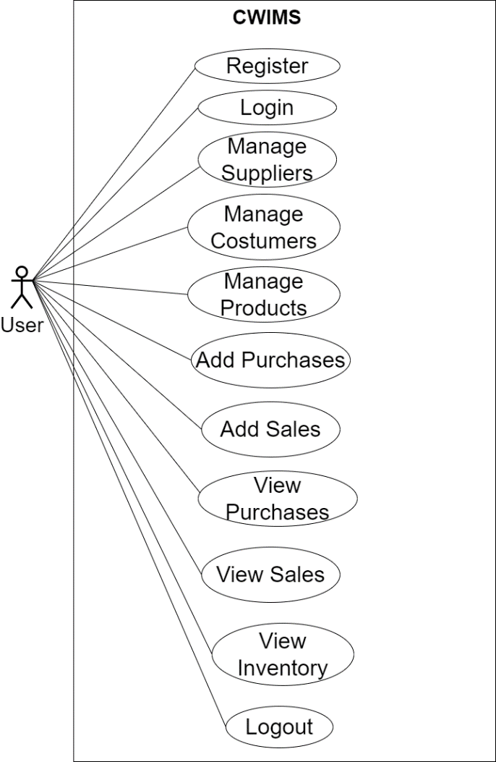
Functional Requirement
Figure: Use Case Diagram of CWIMS

Slide 9
Non Functional Requirement
Performance Requirements.
Usability Requirements.
Environment Requirements
Security Requirements.
Availability Requirements.

Slide 10
Data Modeling

Slide 11
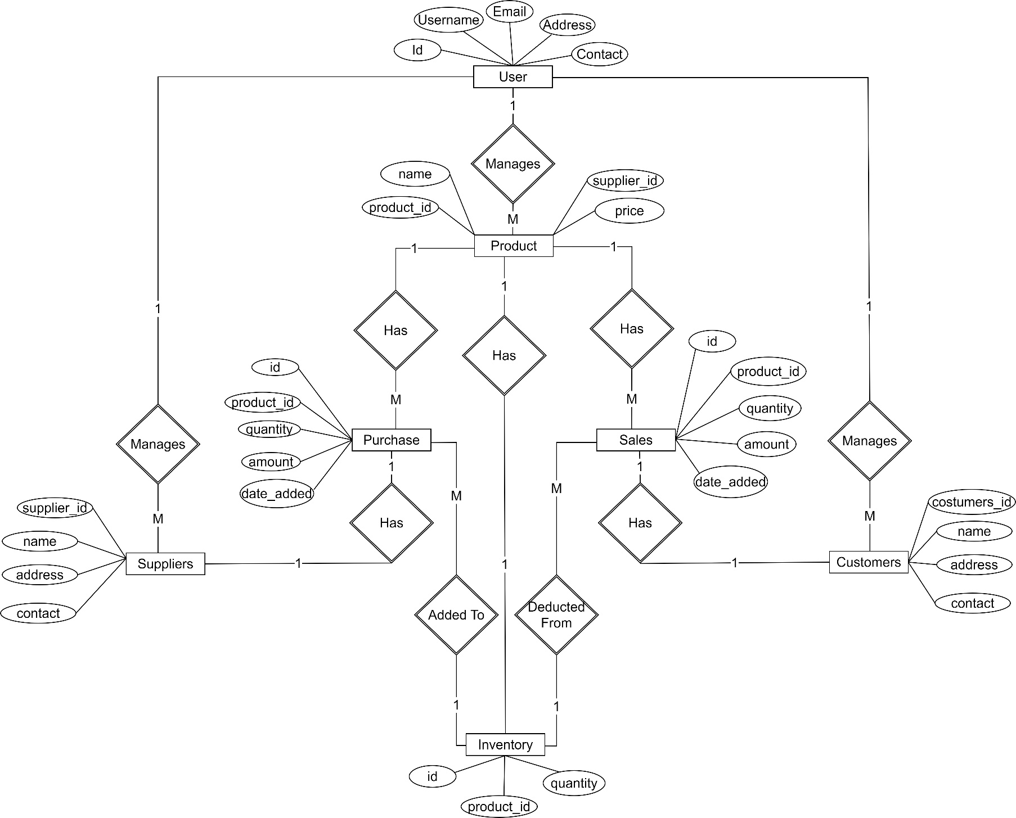
Figure: ER Diagram of CWIMS

Slide 12
Process Modeling

Slide 13
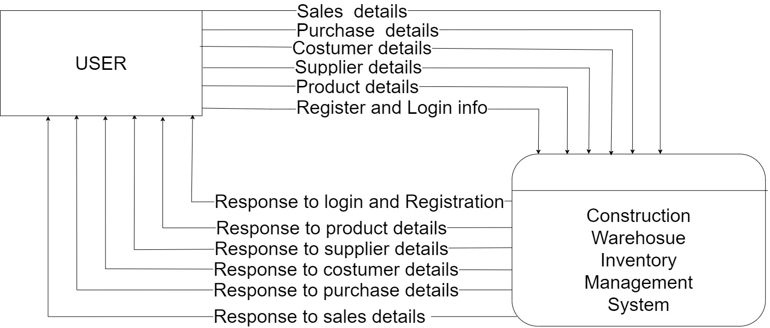
Figure: Context Diagram of CWIMS

Slide 14
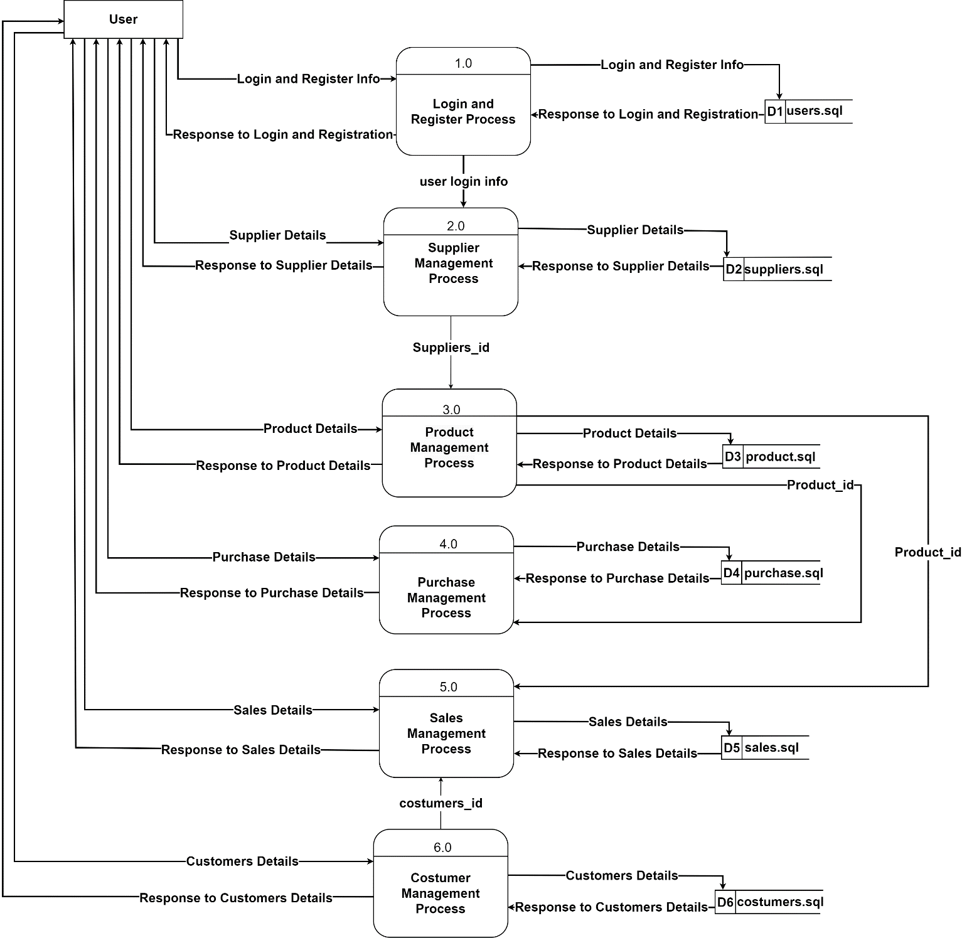
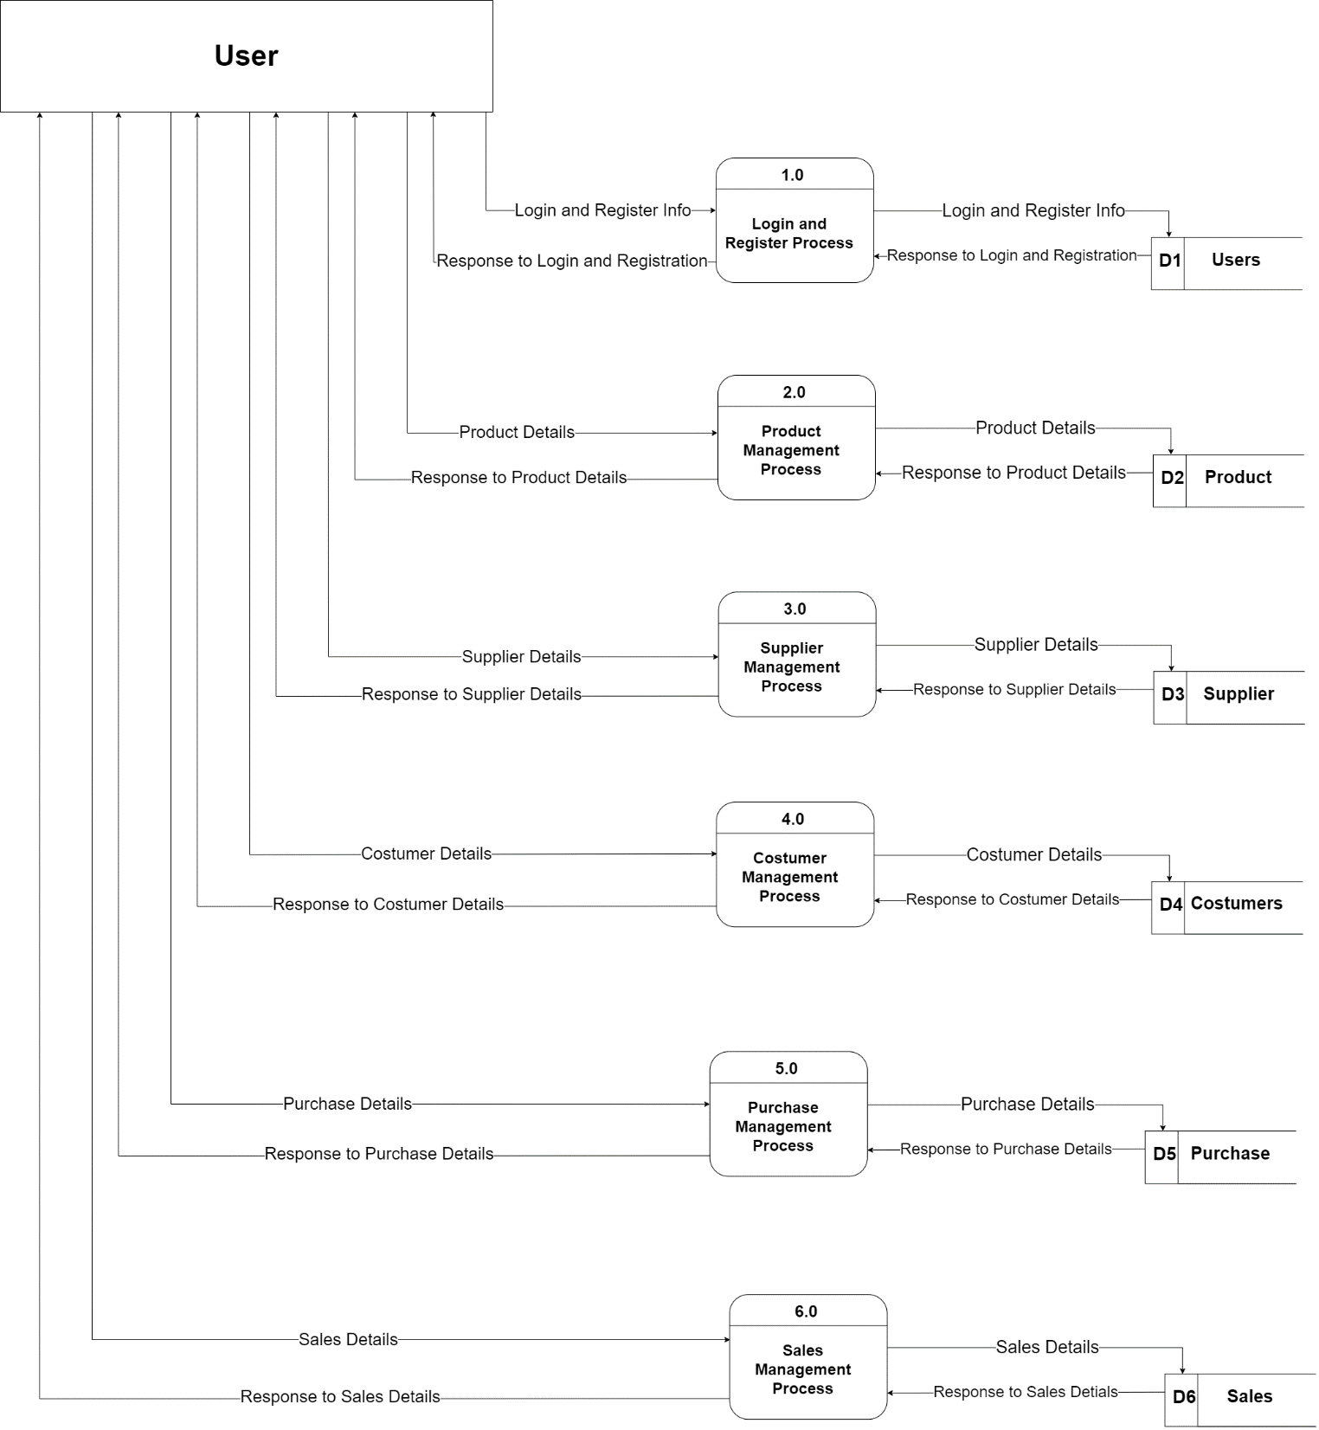
Figure: Level 1 Diagram of CWIMS

Slide 15
Implementation Tool

Slide 16
Tools Used
Draw.io - For drawing diagrams and UI Design
HTML CSS3 JavaScript – Used as Front-end Tool
PHP – Used for back-end programming
MySQL – Used for database
XAMPP – Used for localhost web server
Visual studio Text Editor – For writing both front-end and back-end codes

Slide 17
Conclusion and Future Recommendation
Conclusion
Optimization of inventory levels.
Increased efficiency in managing inventory levels.
Automation of stock levels.
Future recommendation
Chat Bot: Allows to add even the smallest problems.
Payment Options: Add different payment options such as ESewa, Khalti, Cash and Gift Cards etc. Allow to save payment details for future use.
User App: Allows user to add order, check their cart and track their orders.

Slide 18
System Screenshots

Slide 19
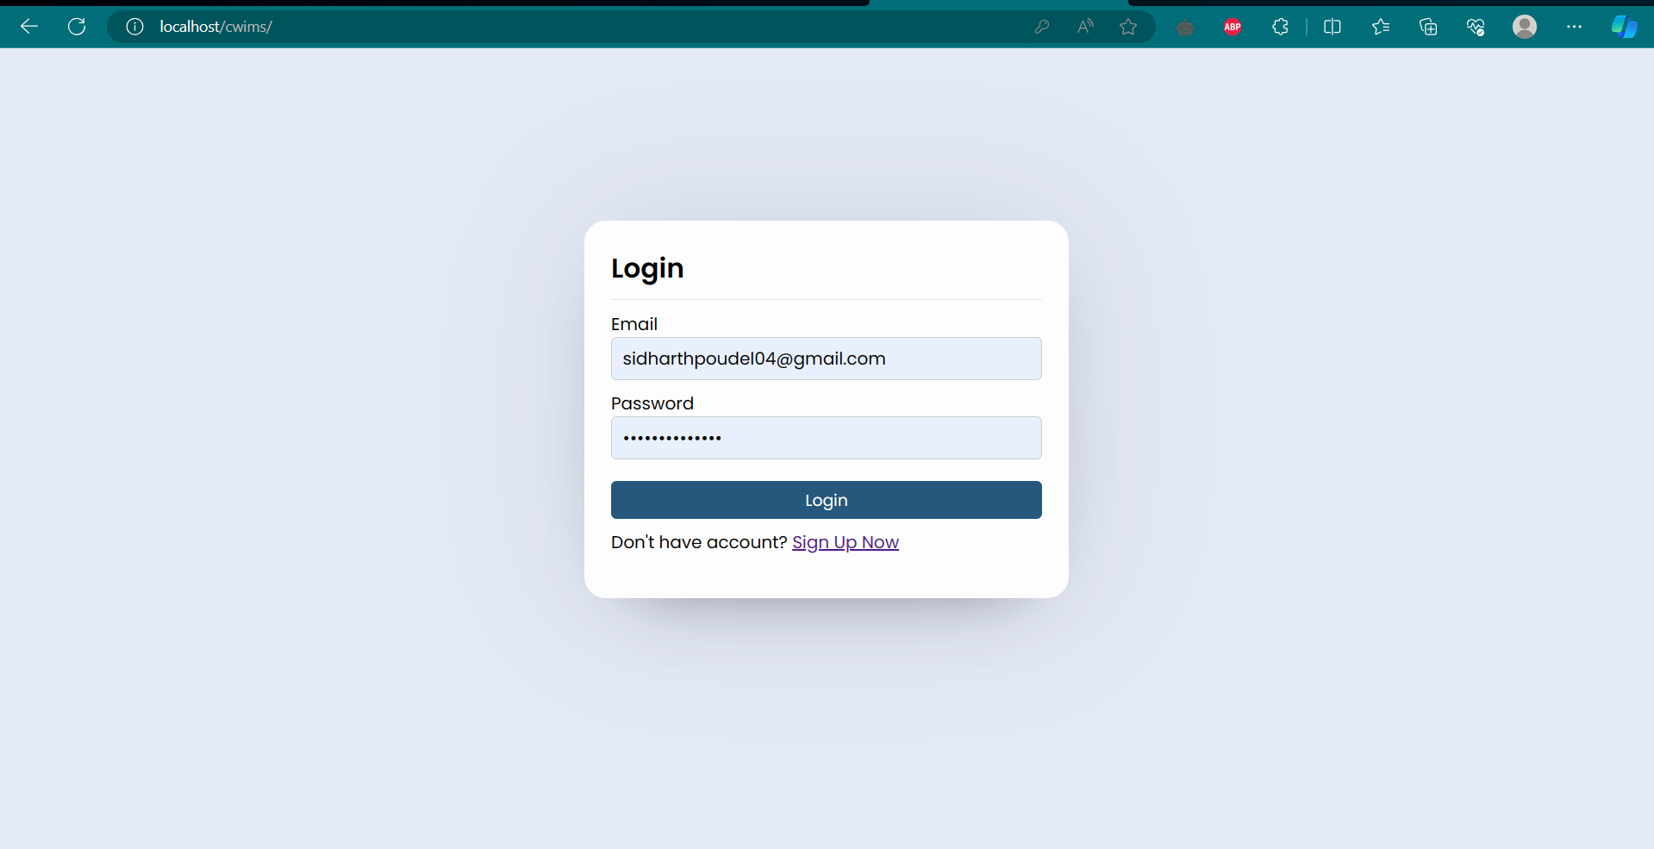

Slide 20
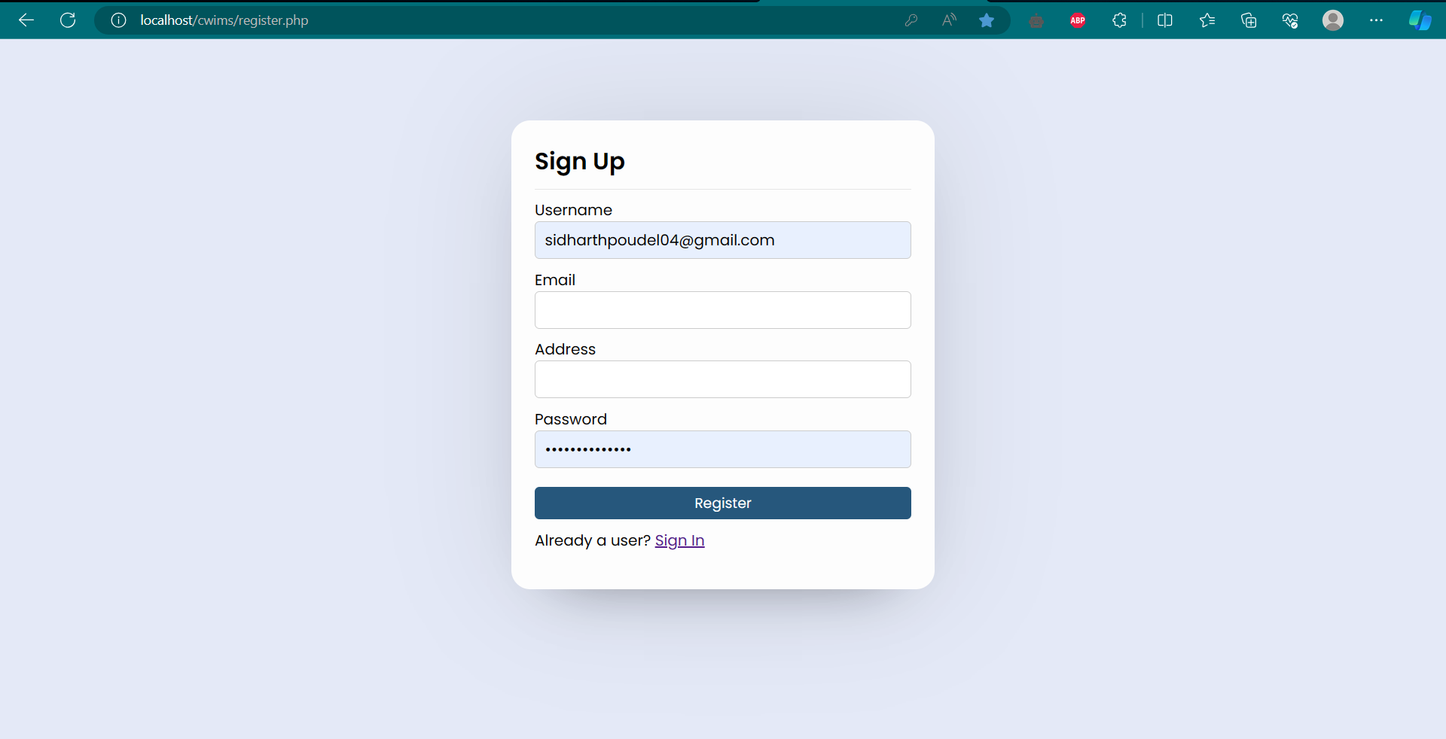

Slide 21
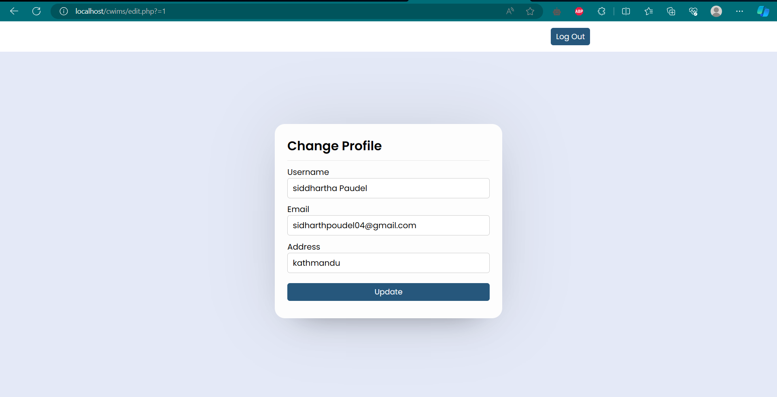

Slide 22
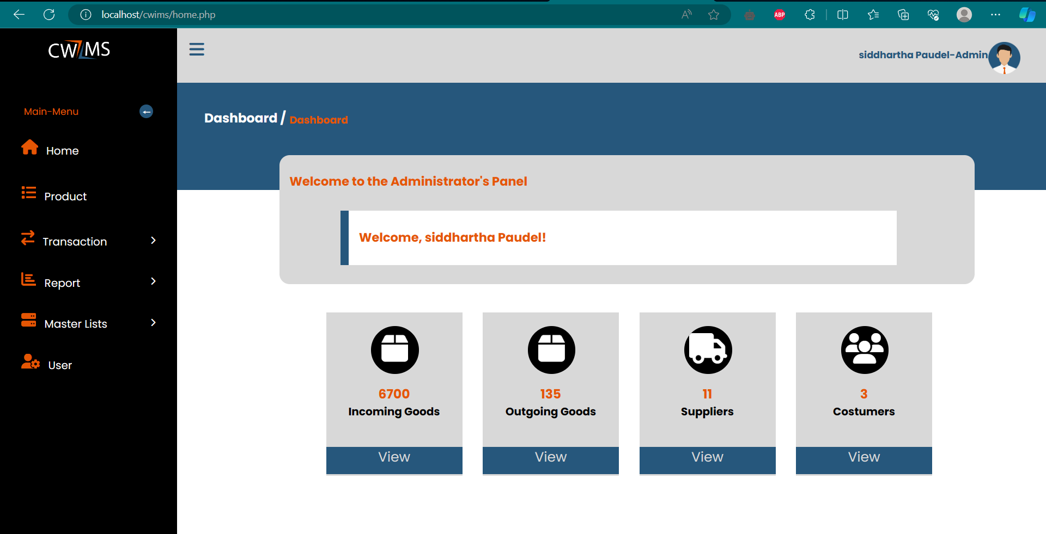

Slide 23
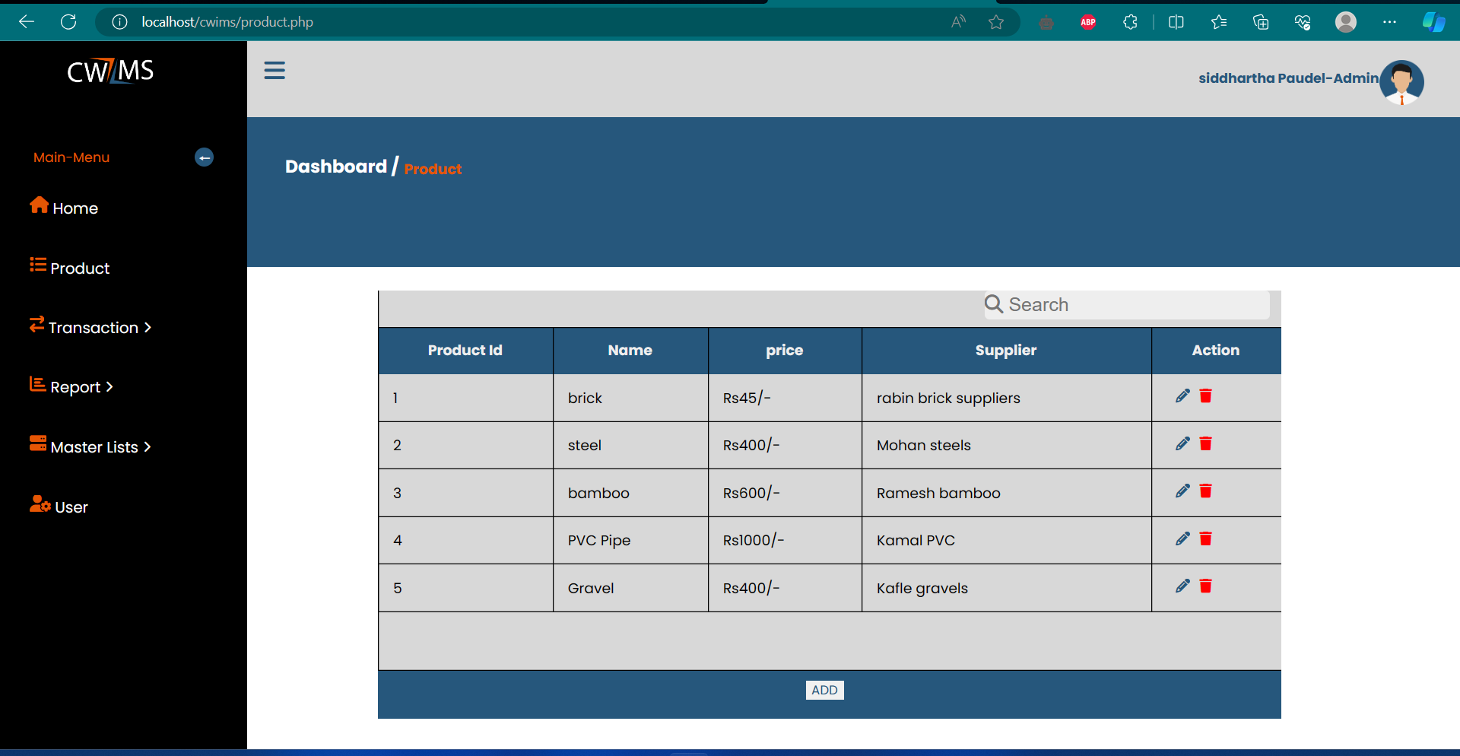

Slide 24
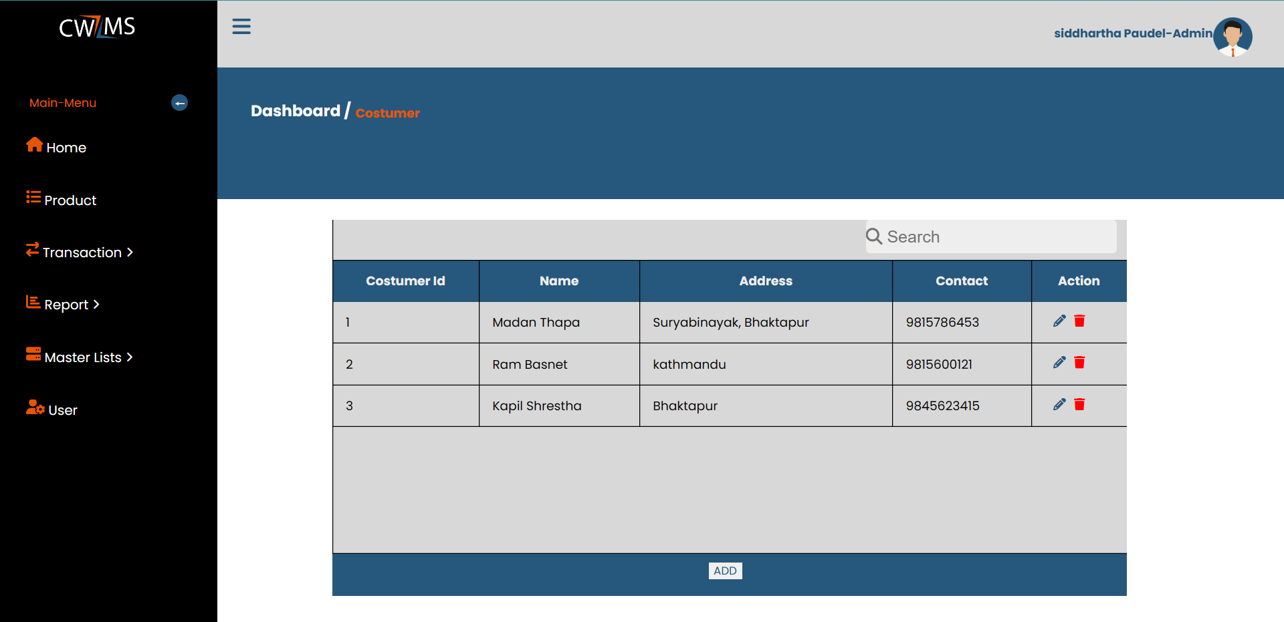

Slide 25
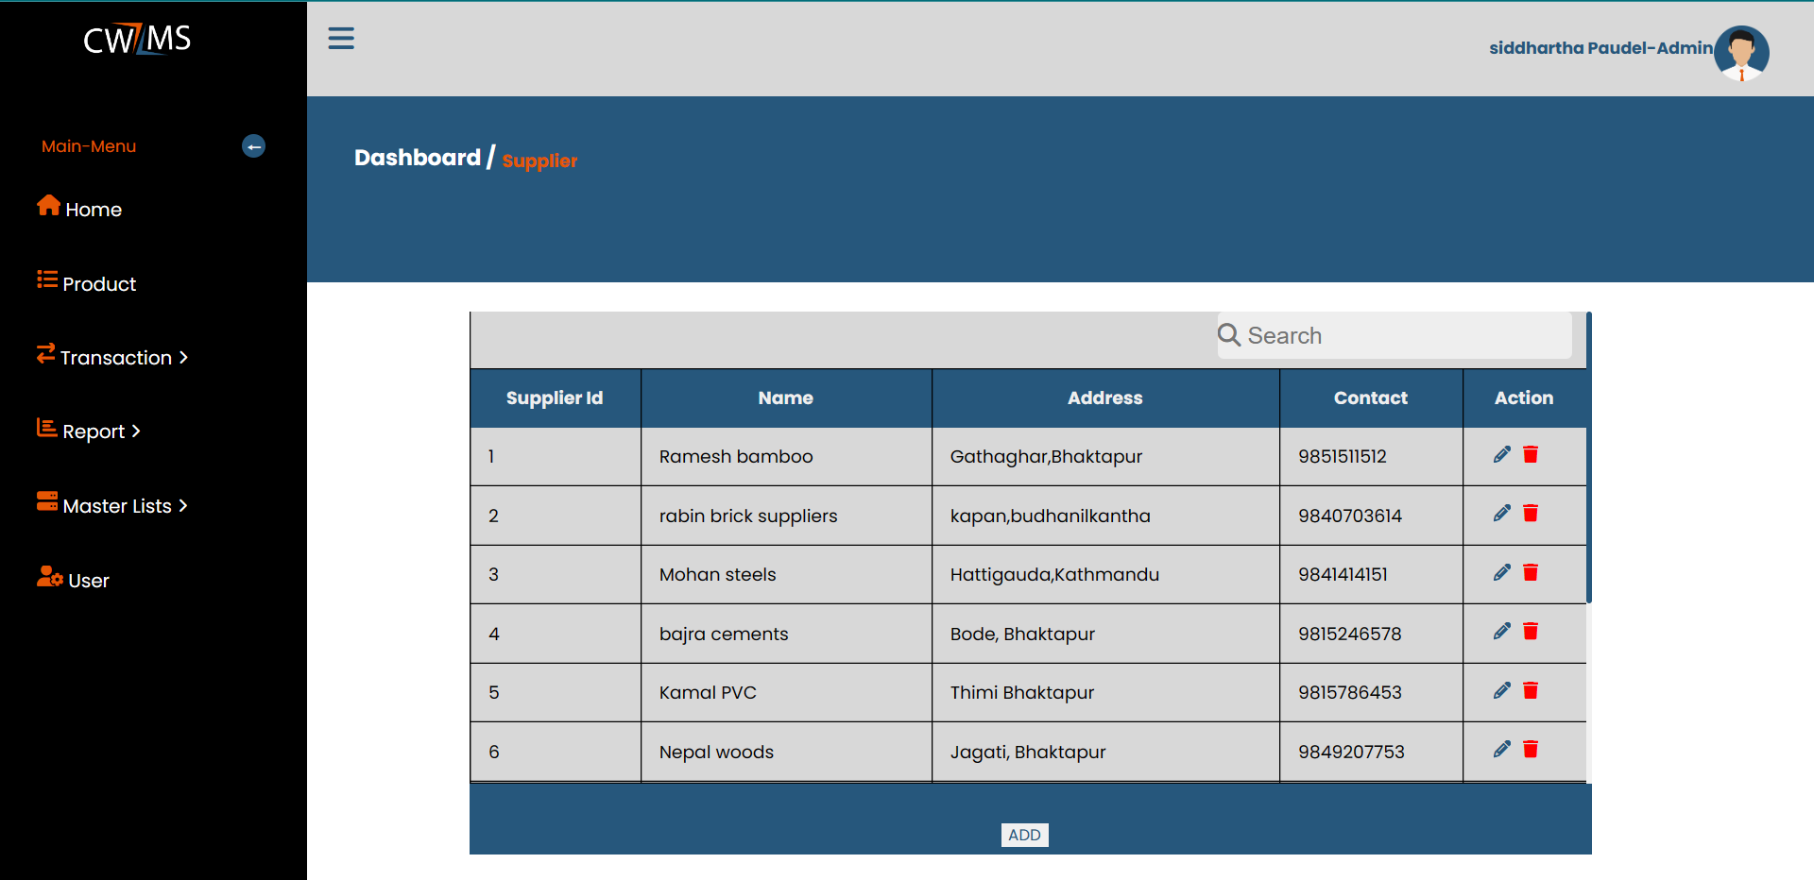

Slide 26
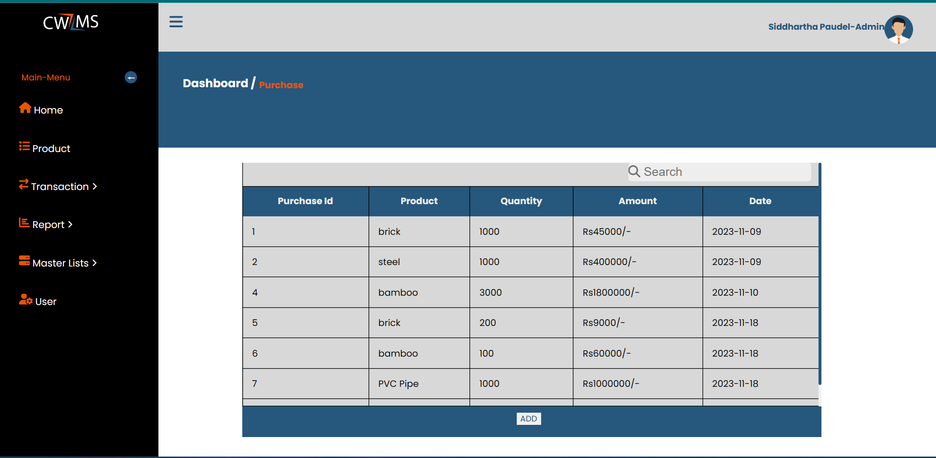

Slide 27


Slide 28
Thank you!

